Slide 1
Error handling
Dr. Navneet Kaur

Slide 2
Error handling
In Django, error handling involves dealing with unexpected situations that can occur while your website or web application is running. These errors could be due to various reasons like invalid user input, database issues, or even programming mistakes.

Slide 3
Debug mode
Debug mode is a setting in Django that controls how errors are displayed to developers. When debug mode is enabled (DEBUG = True in your Django settings), Django will show detailed error pages whenever an error occurs.
These error pages provide a lot of information about what went wrong, including the traceback (the sequence of function calls leading up to the error), the line numbers where the error occurred, and the values of variables at each step.
Debug mode is useful during development because it helps developers quickly identify and fix errors. However, it should be turned off (DEBUG = False) in production environments to prevent sensitive information from being exposed to users.

Slide 4
Custom Error Views
Django allows you to create custom error views to handle errors in a more user-friendly way. Instead of showing the default error pages provided by Django, you can create your own error pages with custom messages, designs, and even suggestions for what the user can do next.
To create a custom error view, you need to define a view function for each type of error you want to handle (e.g., 404 Not Found, 500 Internal Server Error) and configure Django to use these views when the corresponding errors occur.

Slide 5


Example for handling error globally
settings.py
views.py (myproject)

Slide 6
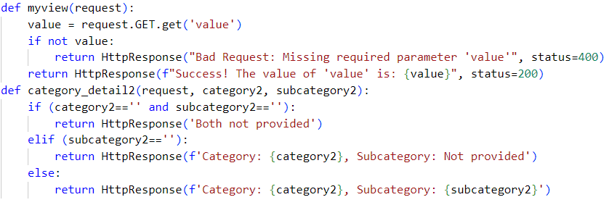
Example for custom error using views locally
views.py (myapp)

Slide 7
Example for custom error using views locally
urls.py (myapp)

